Slide 1
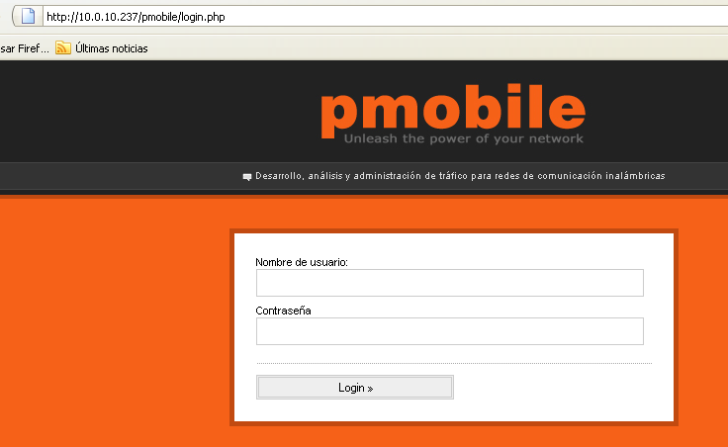
Access to the portal
Local IP
Authentication

Slide 2
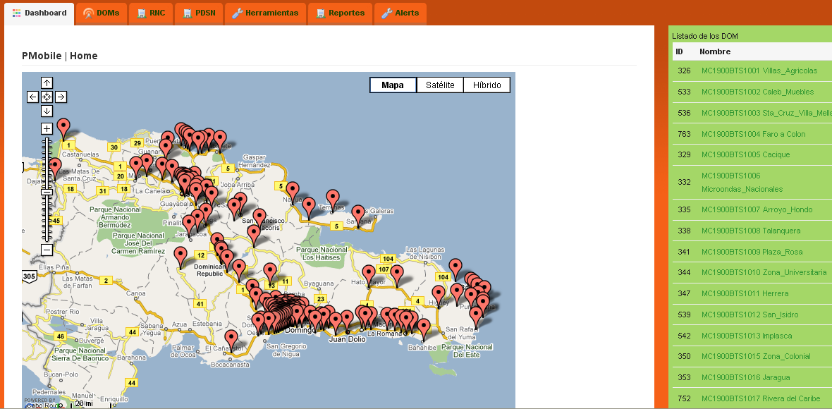
Dashboard
Reports
Different equipments pages
Portal tools
Alerts
Google map tools
Quick access to BTS monitored variables
Map with BTS locations

Slide 3
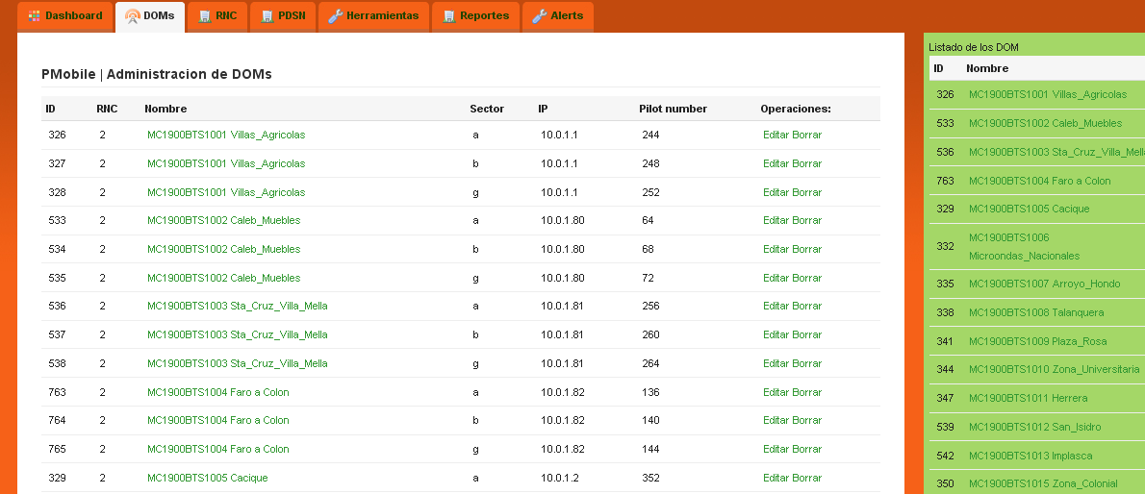
DOMs
Quick access to BTS monitored variables
Dom ips
Doms db editions
List of DOMs by sector
Sectors (a, b and c)

Slide 4
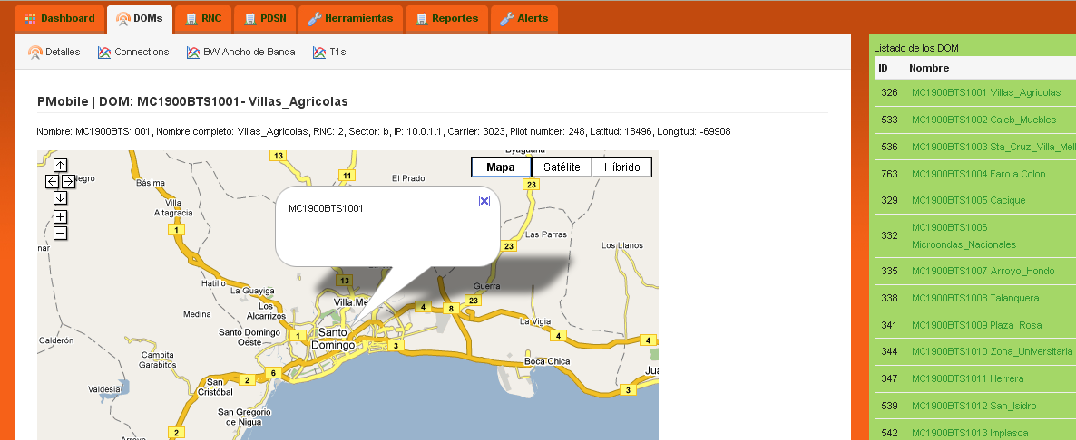
DOM Details
Dom details
Dom location in google map
Quick access to BTS monitored variables

Slide 5

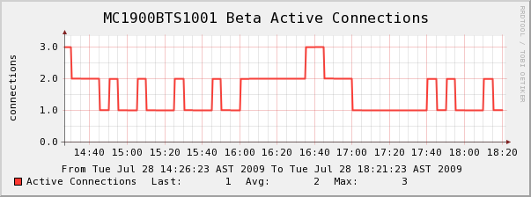
DOM Active Connections
Active connections per sector
Hourly, daily, weekly, montly and yearly reports.
Downloading the data in csv format compactible with Excel.
.
FECHA | AVERAGE(con) | MAX(con)
Tue Jul 28 14:30:00 AST 2009 | 3 | 3
Tue Jul 28 14:35:00 AST 2009 | 2 | 2
Tue Jul 28 14:40:00 AST 2009 | 2 | 2
Tue Jul 28 14:45:00 AST 2009 | 2 | 2

Slide 6
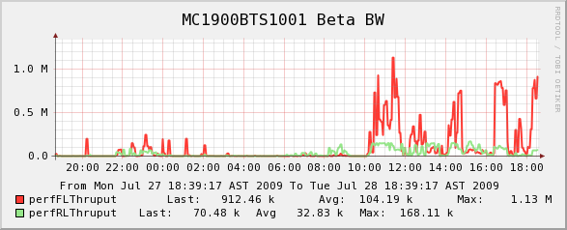
DOM Bandwidth
BW per sector, forward and reverse link.
Hourly, daily, weekly, montly and yearly reports.
Downloading the data in csv format compactible with Excel.
Graphs in png format.
Using Round Robin databases
FECHA | MAX fl (bps) | MAX rl (bps)
Mon Jul 27 18:40:00 AST 2009 | 19744 | 4365
Mon Jul 27 18:45:00 AST 2009 | 25162 | 4981
Mon Jul 27 18:50:00 AST 2009 | 406 | 288
Mon Jul 27 18:55:00 AST 2009 | 3481 | 706

Slide 7
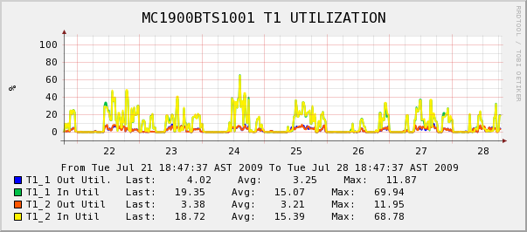
DOM T1/E1 Utilization
T1/E1 Utilization per DOM.
Hourly, daily, weekly, montly and yearly reports.
Downloading the data in csv format compactible with Excel.
Graphs in png format.
Using Round Robin databases
FECHA | AVERAGE IN1 (%) | AVERAGE OUT1 (%)
Tue Jul 21 19:00:00 AST 2009 | 23 | 3
Tue Jul 21 19:30:00 AST 2009 | 6 | 1
Tue Jul 21 20:00:00 AST 2009 | 13 | 2
Tue Jul 21 20:30:00 AST 2009 | 2 | 1

Slide 8
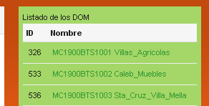
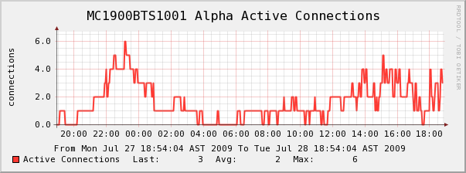
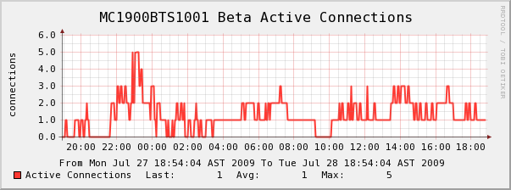
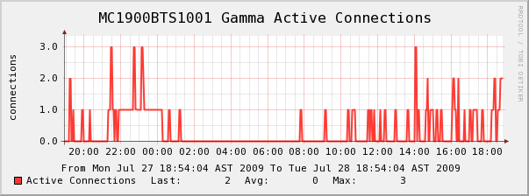
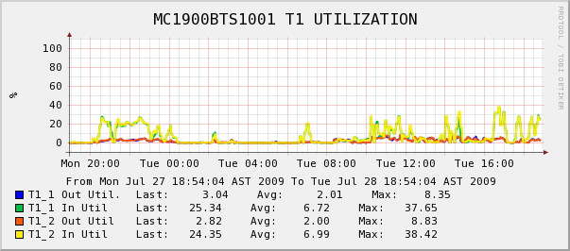
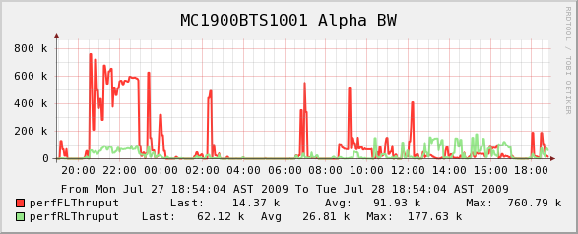
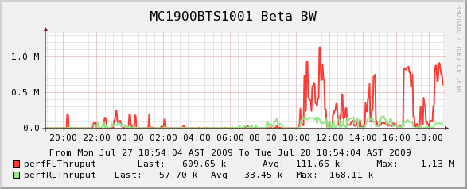
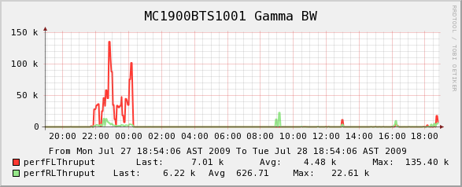
Quick access to BTS monitored variables.

Slide 9

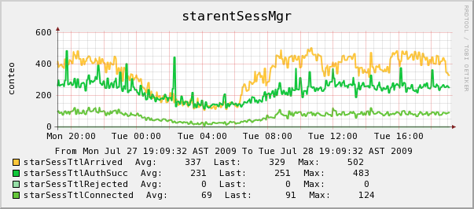
PDSN Session Manager
Working with PDSN 16000
Session Performance
Downloading info to csv format, excel compatible.

Slide 10
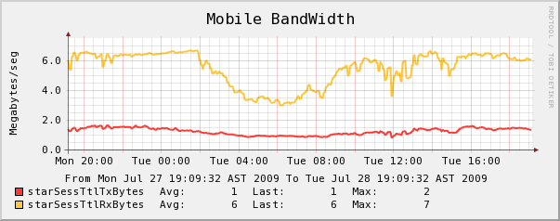
PDSN Mobile BandWidth consumption
Working with PDSN 16000
Mobile tx and rx Bandwidth consumption.
Downloading info to csv format, excel compatible.

Slide 11
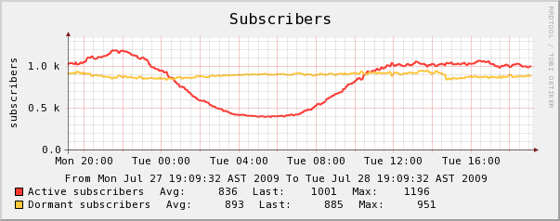
PDSN Sesion subscribers.
Working with PDSN 16000
Active and Dormant subscribers sesions.
Downloading info to csv format, excel compatible.

Slide 12
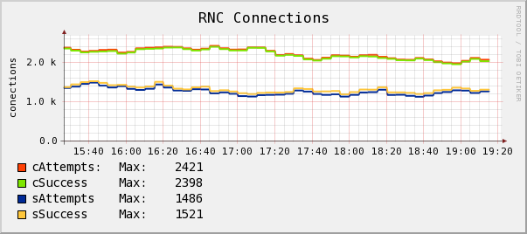
RNC Connections
Radio Network Controller connection performance.
Downloading info to csv format, excel compatible.

Slide 13
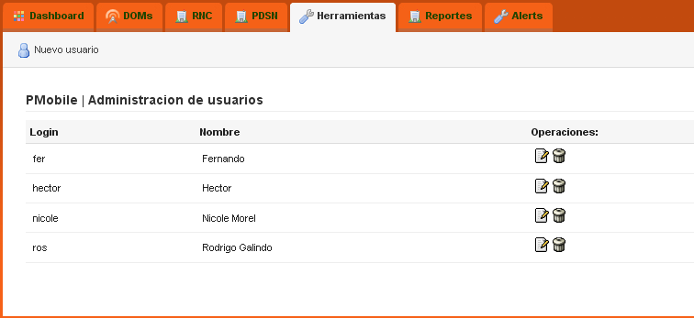
Tools, managing portal users.

Slide 14

Reports
RADIOBASE | SECTOR | PROMEDIO | MAXIMO | FECHA DEL MAXIMO
MC1900BTS1001 | Alpha | 1.50171857 | 5.99E+00 | Mon Jul 27 23:10:00 2009
MC1900BTS1001 | Beta | 1.003333333 | 5.00E+00 | Mon Jul 27 23:10:00 2009
MC1900BTS1001 | Gamma | 0.546735871 | 4.98E+00 | Mon Jul 27 11:20:00 2009
MC1900BTS1004 | Alpha | 0.283748558 | 2.99E+00 | Mon Jul 27 13:05:00 2009
RADIOBASE | SECTOR | PROMEDIO | MAXIMO | FECHA DEL MAXIMO
MC1900BTS1001 | Alpha | 110802.0819 | 9.41E+05 | Mon Jul 27 11:50:00 2009
MC1900BTS1001 | Beta | 145643.0466 | 9.33E+05 | Mon Jul 27 11:00:00 2009
MC1900BTS1001 | Gamma | 4694.80767 | 1.67E+05 | Mon Jul 27 15:20:00 2009
MC1900BTS1004 | Alpha | 0 | 0 | Wed Dec 31 19:30:00 1969
RADIOBASE | PROMEDIO | MAXIMO | FECHA DEL MAXIMO
MC1900BTS1001 | 9.519153531 | 62.85059718 | Mon Jul 27 11:50:00 2009
MC1900BTS1004 | 0.320595906 | 0.818524221 | Mon Jul 27 17:40:00 2009
MC1900BTS1005 | 4.69639375 | 40.42650096 | Mon Jul 27 18:50:00 2009
MC1900BTS1006 | 6.982081391 | 66.78879771 | Mon Jul 27 16:30:00 2009

Slide 15
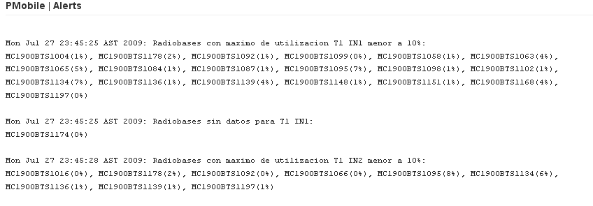
Alerts
Customize alerts for different measurements.
Different trigger configurations.

